Slide 1
.NET Core on the RPi
Easy as Pi!

Slide 2
Key Points
.NET Core is Universal
.NET Core is simple to install
App Dev is a breeze!
Runs on the RaspberryPi
  Raspian (Denbian Linux)
  Windows 10 IoT-Core
Notes:
I would like to first start with some of the key challenges that organizations face as they gear up to leverage IoT solutions to fuel their digital transformation.
1) How do I establish the initial connection between the device and the IoT solution and register the device? How do I ensure that the device has the right configuration at start up?
2) How do I remotely manage my device? Many a times IoT devices are deployed where reachability could be a challenge. Can I have a centalized console using which I can manage all the devices in the field?
3) The 3 rd challenges is probably the biggest as it deals with concerns around privacy and security around the data and the device? How do I ensure that all my decvies have the latest and greatest security patches and is protected from vulnerabilities?
All of these challenges get compounded when you include the scale of IoT devices into the equation. Gartner predicts that there would be over 20 Billion IoT devices by 2020. These challenges are magnified as the scale of deployment incresses. This is where the Azure IoT Services and the Azure Device Agent comes into play

Slide 3
.NET Core is Universal
Runs on both Windows and Linux
Setup .NET Core with specific Runtime or SDK binary
Can then build with same source code on different platforms
Windows
  Including .NET Core
Linux
  Raspian
  MacOS
  Other Linux flavours
Notes:
So what is the Azure Device Agent? The Azure Device agent is an opensource, ready to build package. Its has an extensible plugin model and comes with a set of ready to use device management plugins. It runs on the Windows IoT Code and Windows IoT Enterprise.
So what does it do? It provides device operators the ability to remotely priovision and manage the device. Let me breifly explain each of these
Provisioning: As we spoke about the challenges, we said provisoning is about getting the device to register with the right IoT solution and having it start with the right configuration. So The ADA comes with a device provisioning client. So when the device is powered on, this client uses the provisioning service information to call the provisioing service and get its connection info and the IoT hub assignment for the device. What this means is that the device shows up at the right IoT HUB without the solution operator not having to do anything once the device is shipped to its location.
Manage Device: I mentioned about the plugin model which comes with ready-to-use plugins to enables users to perform device management activities like reboot or timeservice settings remotely. I will go through the complete list of available plugins in the subsequent slide.
Manage Application: In addition to the OS, your device could also have custom applications running on them. Device Agent helps manage these custom UWP application by providing you with the capability to install, upgrade, start or stop application remotely. More on this in the subsequent slides.
creates and manages the Azure IoT Hub identities on the device
manages the cloud connection and its renewal
provides a plug-in model for platform components, which allows easy onboarding to various Azure services, including discovery, initialization, error reporting and state aggregation
comes with a set of ready-to-ship plug-ins for commonly used platform components
leverages Azure IoT Module twin such that a separate UWP app is no longer required in order to connect to Azure IoT Hub

Slide 4
.NET Core is simple to install
  Can use installer where supported
    Windows .msiex installer
      Can’t use on IoT-Core
    apt-get install on Linux
  As of version 3.0 “installation” doesn’t need an installation engine
    I call it copy-paste installation
    Download binary and expand to a folder
    Copy folder to the Pi, through a share
    On Pi set DOTNET_ROOT to point to folder and add that to the PATH
      Environment variables. Use export on Linux
Notes:
In the previous slides I have been talking about the ready-to use plugins for device management activities. These are the plugins currently available:
You can get Device Info – in terms of device ID, manufacturer, firmware version, etc.
Certificate management – that allows you to remotely install or uninstall certificates.
Factory reset – it allows an operator to apply factory image on the device and bringing it to the original state.
Reboot management – you can remotely reboot the device or schedule a reboot during downtime.
Remote wipe – it enables an operator to wipe out all data on the device and restore the device to a clean state. Remote wipe does not uninstall any applications or software that got installed.
Time management - enables an operator to configure a NTP server as well as the time zone for the device.
Windows telemetry management - enables an operator to configure the telemetry level that is being reported from their Windows IoT device.
Windows OS update management - enables an operator to configure Windows Update policies on the device.
Windows Diagnostics – It will enable an operator to configure the diagnostics log that should be sent from the IoT device to the cloud.
UWP App managemnent: It enables na operator to install, unintall, stop or start an application

Slide 5
Debian SDK install script for .NET Core
sudo apt-get update
sudo apt-get install apt-transport-https
sudo apt-get update
sudo apt-get install dotnet-sdk-3.1
https://docs.microsoft.com/en-au/dotnet/core/install/linux-package-manager-debian10

Slide 6
Environment variables
PowerShell- Windows
$addPath = “path to folder”
$arrPath = $env:Path -split ';' | Where-Object {$_ -notMatch "^$regexAddPath\\?"}
$env:Path = ($arrPath + $addPath) -join ‘;’
$env:DOTNET_ROOT = “path to folder”
Linux-Raspian
export DOTNET_ROOT=“path to folder”
export PATH=$PATH:=“path to folder”

Slide 7
dotnet command line
dotnet new
  Create a new project
dotnet add
  Add libraries, Nuget packages
dotnet build
dotnet run
dotnet publish
  For deployment (copy-paste again)

Slide 8
What to build?
dot net new …
Console
Class (.NET Core)
WPF app
WPF class
Windows forms
Blazor
Web (ASP.NET blank)
Mvc (ASP.NET web app)
Razor

Slide 9
Where to build?
Once “setup” can run dotnet commands on the Rpi
dotnet publish --runtime win-arm --framework 3.1 --self-contained false
Or can dotnet publish on the desktop and copy result to Pi
  In Visual Studio I set the publish folder to a share on the Pi

Slide 10
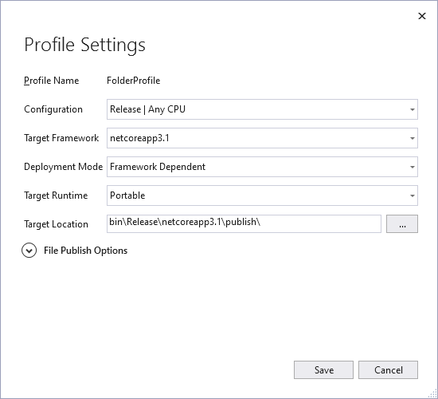
Publish options

Slide 11
Call to Action
My blog https://www.sportronics.com.au
Get an .NET Core SDK binary from here, do setup as on previous slide, and try app dev on the Pi https://dotnet.microsoft.com/download/dotnet-core/3.1
Try az-iothub-ps let me know your feedback as comments on my blog https://github.com/djaus2/az-iothub-ps
And
https://techcommunity.microsoft.com/t5/azure-iot/net-core-quicksstarts-done-quickly-with-one-powershell-script/m-p/1199678
davidjones@sportronics.com.au
@cedriverwiz

